Slide 1
2025 #DAFRIDER Kickoff Briefing
*TEMPLATE*
(replace all RED items with your local information)
(Use your MAJCOM/FLDCOM approved slide deck)

Slide 2

CC COMMENTS
XXXX, Colonel, USAF
Commander
XXXXXXX
(Insert appropriate “patch” here)

Slide 3
Overview
#DAFRIDER 2025 Kickoff
AFSEC Goals
Training & PPE Requirements
Responsibilities
How to improve as a #DAFRIDER
Year of the Swerve
Local Riding Hazards / Conditions
Updates: Airbag Vests, Lessons Learned & Mentorship
Mishap Statistics

Slide 4


2025 #DAFRIDER Kickoff
  Commander’s Responsibilities
  Know your #DAFRIDERs
    CC/MSRs identify 100% of your unit’s riders
    Ensure that every #DAFRIDER is in MUSTT
  Get your #DAFRIDERs the training they need
    CC/MSRs verify training requirements and schedule training.

Slide 5
2025 #DAFRIDER AFSEC Goals
  Review all DAF Installation’s Rider training
    Data call will be sent to all MAJCOMs/installations to provide Rider training stats i.e., number of classes, students, coaches, and budget etc. . .
    Working on acquiring Airbag Demo vests for all Safety Offices
    Airbag vests help reduce the severity of Motorcycle accidents
    Updating MUSTT to recognize Certified Ridercoaches.
    MUSTT will be able to track Ridercoaches and their certifications.

Slide 6
#DAFRIDER Training Requirements
Minimum #DAFRider Requirements
License (or permit prior to course)
License = Level I training complete
Level I training (BRC or equivalent) = Level 1 training complete
MUSTT Update
Required annually AND after training is complete
Continuation training (Level II)
Within 6-months, not to exceed 1-year
Sustainment training (Level III)
At least every 5-years

Slide 7
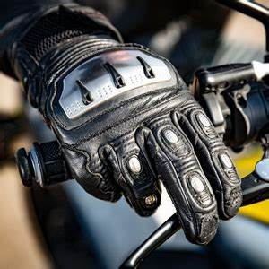
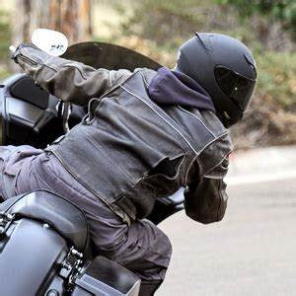
#DAFRIDER Training Requirements
To Schedule Training
Scheduling is accomplished via the web at: XXXXX
  Training Season starts in: March
  Training Season ends: October
Special Classes?
  WBRC
  Unit Needs
Notes:
Update to show how someone from your Base would sign up for training.

Slide 8

#DAFRIDER PPE Requirements
Minimum #DAFRIDER Requirements
Approved Helmet - DOT/SNELL/ECE
Eye Protection – Meets or exceeds ANSI Z87.1-2020
Long-sleeved shirt/jacket
Full-fingered gloves
Full-length pants
Sturdy over-the-ankle footwear
Optional #DAFRIDER PPE
Airbag Vest
Armored Vests
Elbow / Knee pads
Chaps
Cooling / Heating vests
Racing suits

Slide 9
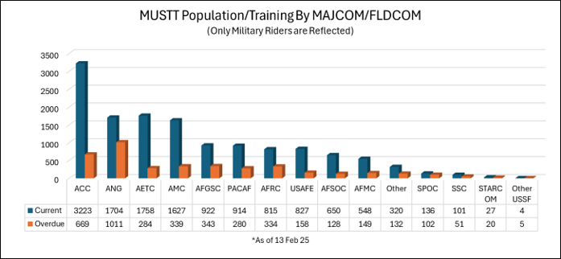
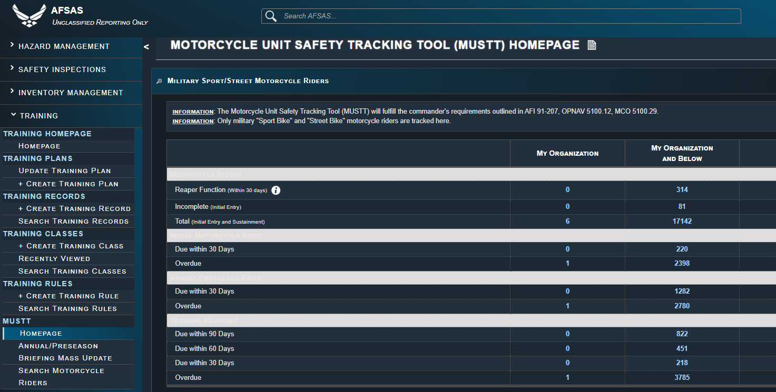
#DAFRIDER Responsibilities
Log into MUSTT
  Record your training classes
  Document briefings you have given or attended
  Keep your records up to date and accurate
  Is your Motorcycle information current?

Slide 10
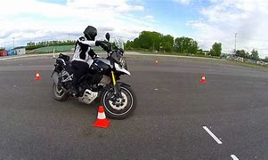
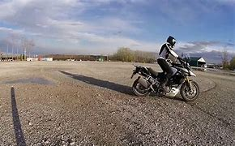
How to improve as a #DAFRIDER
Skills Building
  Training – Get caught up and stay trained
  Advanced training (track, ADV, etc.) – Invest in your own riding!
  Practice EVERYTIME you ride!
  Braking, tight circles, and cornering – warms your tires and your skills!
  Ride within YOUR skill level – Don’t push it
Personal Accountability
  Practice before you ride
  NEVER drink and ride
  SLOW DOWN! Where do you have to be? Is it worth your life?
  Ride within YOUR skill level – Don’t push it
  Wear as much gear as you can…ALWAYS!

Slide 11
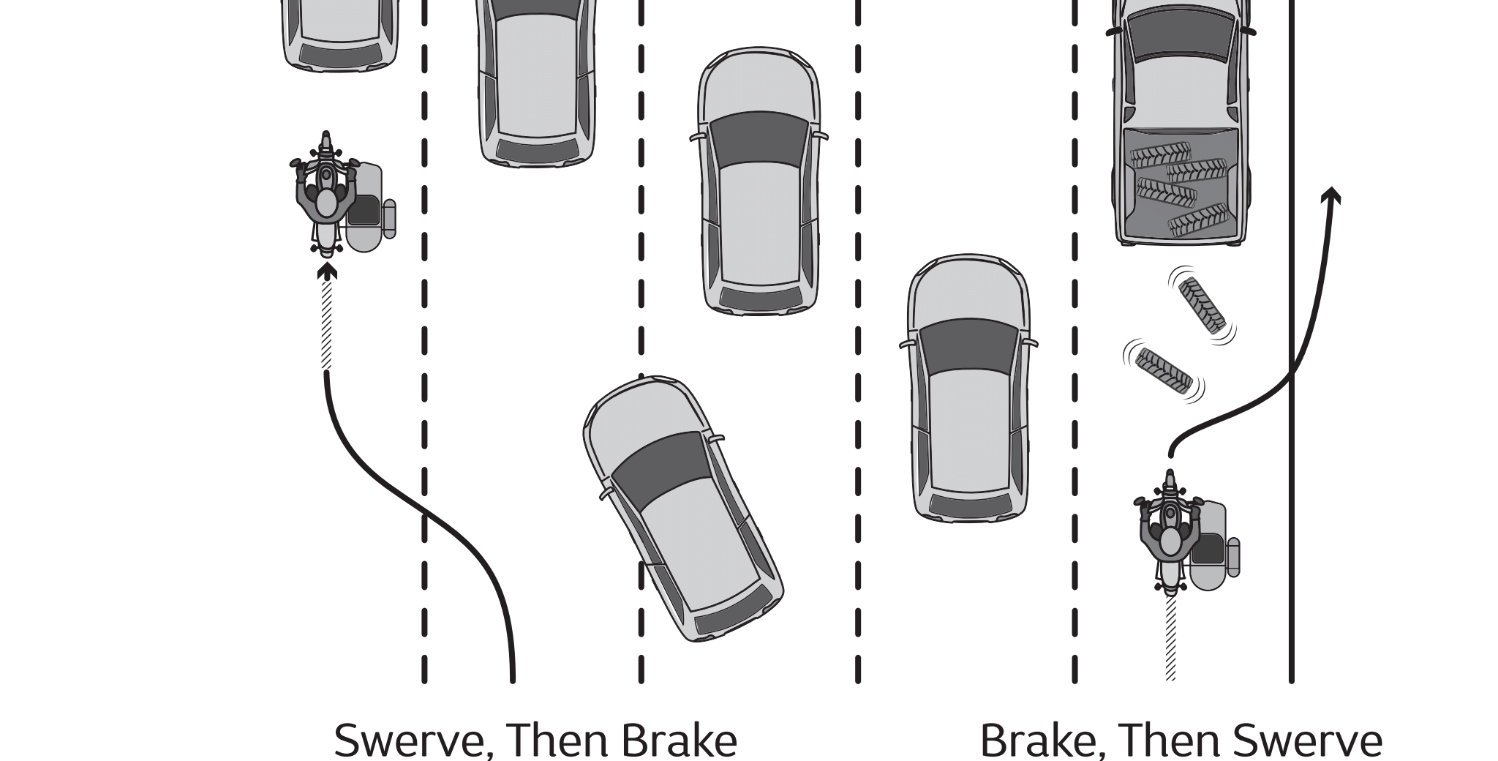
Year of the Swerve
Steps of a good Swerve
  Always be looking for escape paths
  Use counter steering to conduct the swerve
  Keep your body upright during swerving
  DO NOT BREAK DURING THE SWERVE
  If you must break, break before or after conducting a swerve
Learning to Swerve
  Training – BRC-1 Covers the basics
  Practice makes perfect
    Take the time to be comfortable swerving
    Practice in a parking lot, or controlled area
  Ask a mentor for help

Slide 12
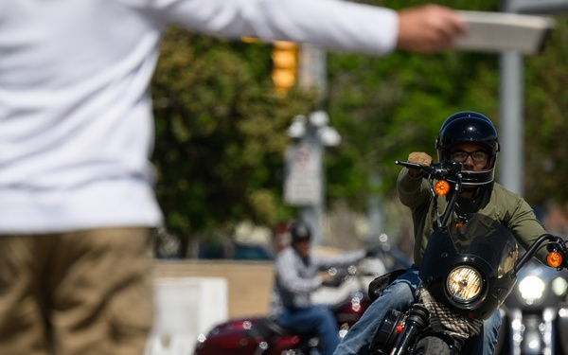
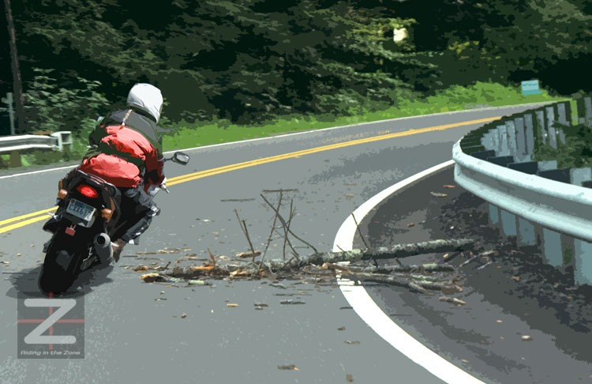
Year of the Swerve
Why do I need to know how to Swerve?
  Swerving can help you avoid obstacles quickly
  Learning proper swerve techniques creates a better understanding of counter steering
  Understanding counter steering increases Skill level
  A correctly executed Swerve can save your life!
Notes:
Have a good discussion about swerving, share a story.

Slide 13
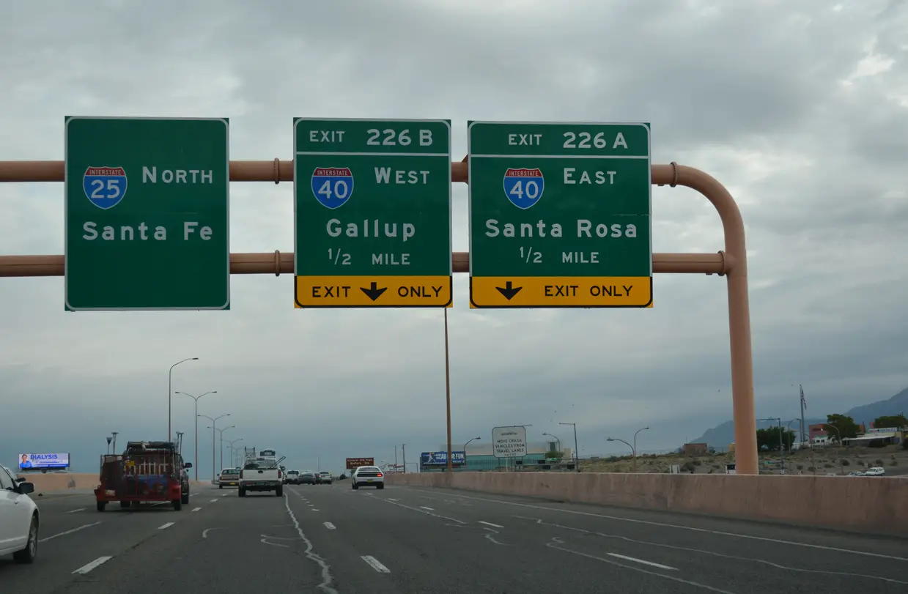
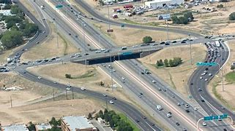
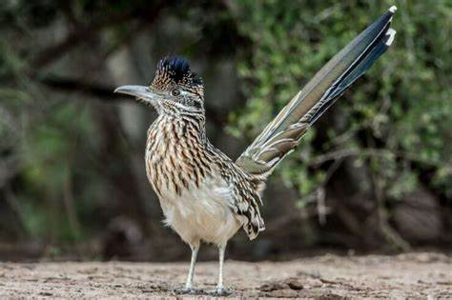
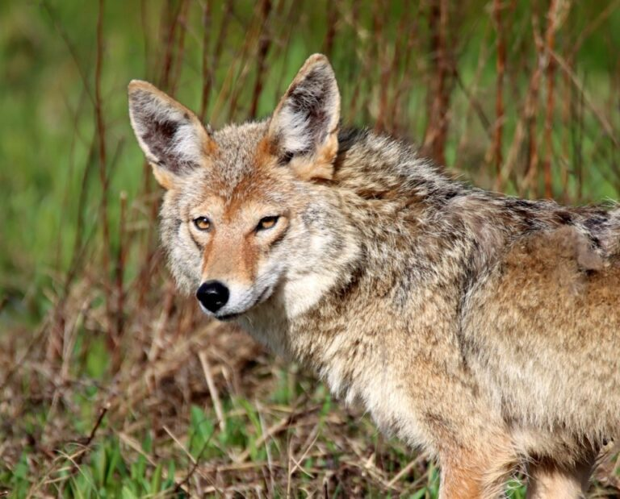
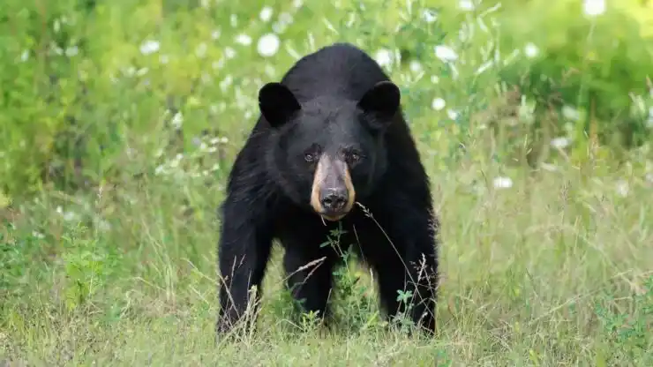
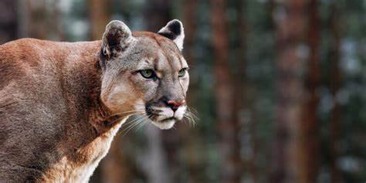
Local Riding Hazards (Example)
Local Hazards
  Higher Risk Environment in and around Albuquerque
    Sandia Crest Scenic Highway
    Highway 14 to Santa Fe
    Big I: I-40 and I-25 interchange
    Paseo Del Norte and I-25 All intersections along Montgomery
    Any construction zone
  Animals: Dogs, Bear, Coyote, Prairie Dogs, Mountain Lion, Deer, Elk
  Other Drivers: Red-light runners and aggressive on Yellow
  Survival Secrets
    Speed (Stay within your capabilities)
    Watch the wheels (PMV 4)
    Don’t challenge for your right of way (smaller and lighter)
Notes:
Take out Albuquerque and any pictures that do not pertain to your local area and update with your local hazards.

Slide 14

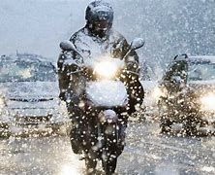
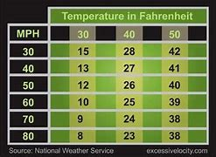
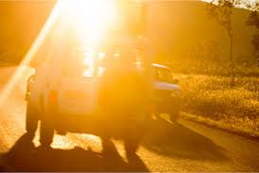

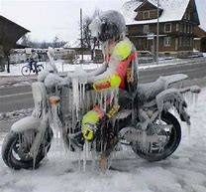
Local Riding Conditions (Example)
Weather
Temperatures
  Winter (21º to 46º)/Summer (64º to 100º)
    Temp under 33º watch for Black Ice
    Temp over 70º heat exhaustion (dress for the ride)
Wind (0 to 65+ MPH)
  Sand across roadway
  Visibility reduced
  Cross wind
  Dust/Sand Devils
  Tumbleweeds
Rain (Jan .4”) (Jul 1.4”)
  Sand and gravel across roadway
Sun behind you as you approach a Green Light – Will the car turning left see you?
Notes:
Update to your local conditions

Slide 15
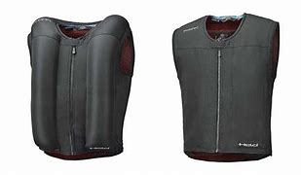
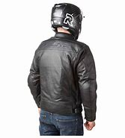
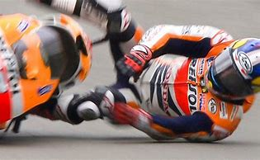
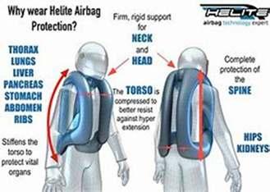
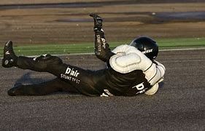
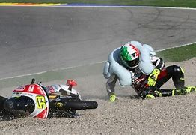
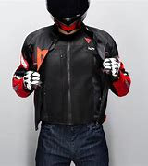
2025 #DAFRIDER Updates
Airbag Vest Initiative
  Long range goal: All #DAFRIDERS will be wearing Airbag Vests every time they rider.
  Short range goal: All Installations will be issued Airbag Vests to demonstrate how they work
  Demo vests to be purchased by AFSEC
  Training will be provided to Safety offices/Ridercoaches
  Airbag Vests can reduce the severity of injuries during mishaps
Notes:
Airbag vest: Many new styles, designs, and prices through various vendors (most offer military discount with a called in order) (Helite and Dainese websites, enter “DAFRIDER” for 10% off)

Slide 16
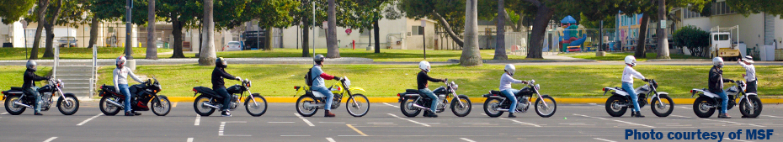
MSF Mentorship Course Notes
17 Exercises and 52 discussion topics based on needs of the group
Done in any flat area with open space (parking lot suggested)
Mentor Coach cards and cones will be issued/used
Ex. A mentor may find that the small group (2-3 mentees) struggles with cornering. The mentor could then focus on a few of the 17 exercises (2-4 of them) that focus on cornering, and lead specific discussion points, on cornering
QR code on cards to discuss points (mentees can keep the questions for later references based on the QR)
Immediate Application
Not all exercises need to be used in each session (suggested 2-4 exercises over a few hours)
Notes:
MSF Mentorship Course: Still awaiting MSF and DoD review for release of final product. DAF release should be shortly after (pending regulatory updates to 91-207 and 6055.04)
Once review is done, a call for training classes will be sent out.

Slide 17
Mishap Statistics (Example)
FY20-FY24
  DAF (76 Fatal, 5 PTD, 10 PPD, 741 LT)
    18,370 Lost Work Days, $800,756,796.00 in Mishap Costs
  KAFB (0 Fatal, 0 PPD, 1 PTD, 6 LT)
    311 Lost Work Days, $1,693,000.00 Mishap Costs
  AFSEC (0 Fatal, 0 PPD, 0 LT)
  AFIA (0 Fatal, 0 PPD, 0 LT)
Primary PMV2 Mishap Causes: SPEEDING, PMV4 turning LEFT, ALCOHOL, BEHAVIOR
Notes:
Steve to update

Slide 18
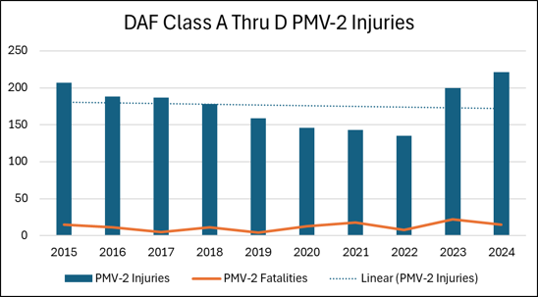
Mishap Statistics
Steady mishap decline since 2014 to 2022
48% Spike FY23 10% increase in FY24
35% PMV-2 mishap decrease between 2014 & 2022
Prevention efforts only work with leadership involvement
The difference between a minor mishap and a fatality is often only a small thing like sand on a corner or a curb being hit vs. a smooth shoulder

Slide 19
CC COMMENTS
XXXX, Colonel, USAF
Commander
XXXXXXX
(Insert appropriate “patch” here)

Slide 20
Summary
#DAFRIDER 2025 Kickoff
AFSEC Goals
Training & PPE Requirements
Responsibilities
How to improve as a #DAFRIDER
Year of the Swerve
Local Riding Hazards / Conditions
Updates: Airbag Vests, Lessons Learned & Mentorship
Mishap Statistics

Slide 21
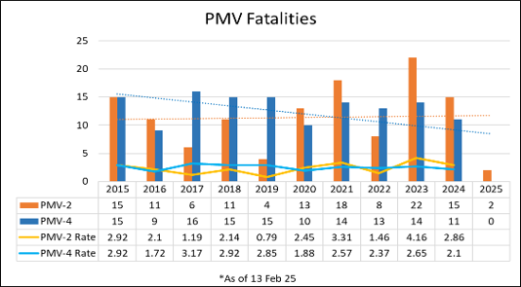
Thank You & Ride Safe!
2025 #DAFRIDER Kickoff – HAVE YOU LOGGED INTO MUSTT LATELY?
AFSAS.SAFETY.AF.MIL

